Slide 1
Design and Analysis of Algorithms Single-source shortest paths, all-pairs shortest paths
Presented By Muhammad Atif Tahir
Slides from: Haidong Xue and Dr. Fethi Jarray

Slide 2
Shortest-Path Problems
Single-source. Find a shortest path from a given source to each of the vertices
Single-pair. Given two vertices, find a shortest path between them. Solution to single-source problem solves this problem efficiently, too
All-pairs. Find shortest-paths for every pair of vertices

Slide 3
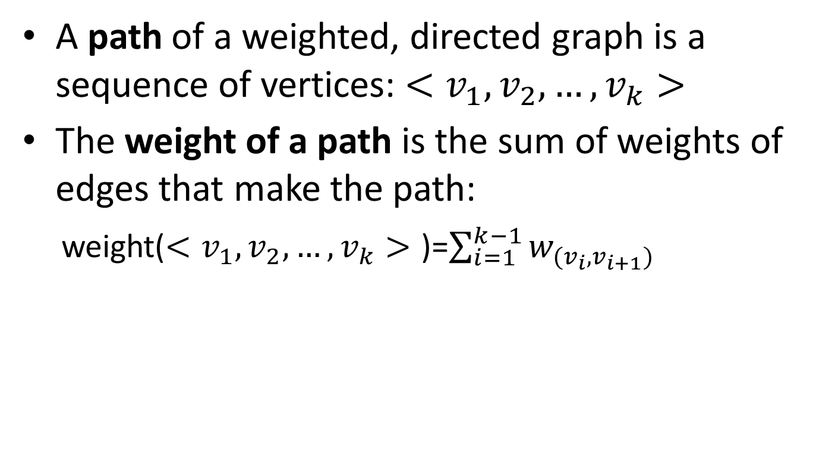
Single-source shortest paths
A path of a weighted, directed graph is a sequence of vertices: $<v_{1},v_{2}, …,v_{k}>$
The weight of a path is the sum of weights of edges that make the path:
weight($<v_{1},v_{2}, …,v_{k}>$ )=$\sum_{i=1}^{k−1}{w_{(v_{i},v_{i+1})}}$

Slide 4
Single-source shortest paths
1
2
3
10
3
2
9
1
6
4
5
7
4
5
2
Given this weighted, directed graph, what is the weight of path: <1, 2, 4>?
10+2=12

Slide 5
Single-source shortest paths
1
2
3
10
3
2
9
1
6
4
5
7
4
5
2
Given this weighted, directed graph, what is the weight of path: <1, 2, 4, 2, 4>?
10+2 + 3 + 2 = 17

Slide 6
Single-source shortest paths
1
2
3
10
3
2
9
1
6
4
5
7
4
5
2
Given this weighted, directed graph, what is the weight of path: <1, 2, 4, 1>?
10 + 2 + $∞$ = $∞$

Slide 7
Single-source shortest paths
1
2
3
10
3
2
9
1
-6
4
5
7
4
5
2
Given this weighted, directed graph, what is the weight of path: <5, 3, 5> and <5, 3, 5, 3, 5>??
4-6 = -2 and -6+4-6+4 = -4
Negative cycle
There is no shortest path from 1 to 5

Slide 8
Single-source shortest paths
Shortest path of a pair of vertices <u, v>: a path from u to v, with minimum path weight
Applications:
Your GPS navigator
If weights are time, it produces the fastest route
If weights are gas cost, it produces the lowest cost route
If weights are distance, it produces the shortest route

Slide 9
Single-source shortest paths
Single-source shortest path problem: given a weighted, directed graph G=(V, E) with source vertex s, find all the shortest (least weight) paths from s to all vertices in V.

Slide 10
Single-source shortest paths
Two classic algorithms to solve single-source shortest path problem
Bellman-Ford algorithm
A dynamic programming algorithm
Works when some weights are negative
Dijkstra’s algorithm
A greedy algorithm
Faster than Bellman-Ford
Works when weights are all non-negative

Slide 11
Bellman-Ford algorithm
Observation:
If there is a negative cycle, there is no solution
Add this cycle again can always produces a less weight path
If there is no negative cycle, a shortest path has at most |V|-1 edges
Idea:
Solve it using dynamic programming
For all the paths have at most 0 edge, find all the shortest paths
For all the paths have at most 1 edge, find all the shortest paths
…
For all the paths have at most |V|-1 edge, find all the shortest paths

Slide 12

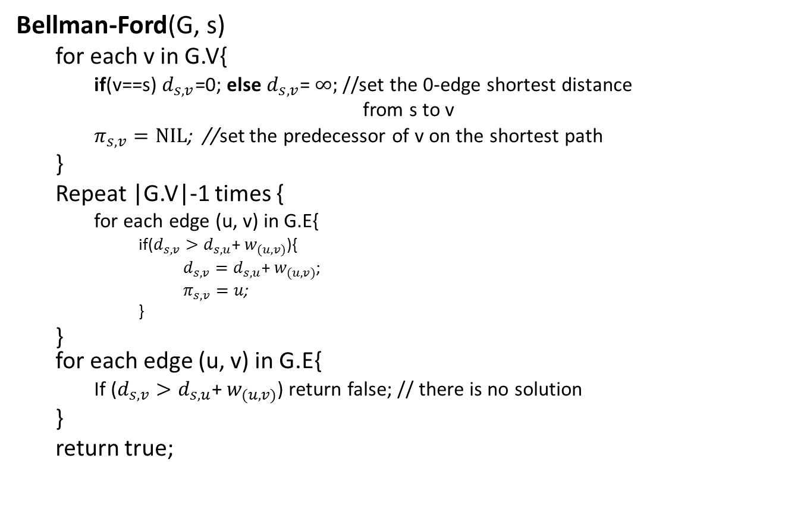
Bellman-Ford algorithm
Bellman-Ford(G, s)
for each v in G.V{
if(v==s) $d_{s,v}$=0; else $d_{s,v}$= $∞;$//set the 0-edge shortest distance
from s to v
$π_{s,v}=NIL$; //set the predecessor of v on the shortest path
}
Repeat |G.V|-1 times {
for each edge (u, v) in G.E{
if($d_{s,v}>d_{s,u}$+ $w_{(u,v)}$){
$d_{s,v}=d_{s,u}\text{+ }w_{(u,v)}$;
$π_{s,v}=u$;
}
} for each edge (u, v) in G.E{
If ($d_{s,v}>d_{s,u}$+ $w_{(u,v)}$) return false; // there is no solution
}
return true;
//Initialize 0-edge shortest paths
//bottom-up construct 0-to-(|V|-1)-edges shortest paths
//test negative cycle
T(n)=O(VE)=O($V^{3}$)

Slide 13

Bellman-Ford algorithm
e.g.
20
0
$$∞$$
$$∞$$
1
10
2
1
3
What is the 0-edge shortest path from 1 to 1?
<> with path weight 0
What is the 0-edge shortest path from 1 to 2?
<> with path weight $∞$
What is the 0-edge shortest path from 1 to 3?
<> with path weight $∞$

Slide 14








Bellman-Ford algorithm
e.g.
$$∞>0+20$$
20
$$d_{1,3}=20$$
0
$$∞$$
$$/10$$
$$∞$$
$$/20$$
$$∞>0+10$$
1
10
2
1
3
$$d_{1,2}=10$$
What is the at most 1-edge shortest path from 1 to 1?
$∞=∞$+1
<> with path weight 0
$$d_{1,3} unchanged$$
What is the at most 1-edge shortest path from 1 to 2?
<1, 2> with path weight 10
What is the at most 1-edge shortest path from 1 to 3?
<1, 3> with path weight 20
In Bellman-Ford, they are calculated by scan all edges once

Slide 15








Bellman-Ford algorithm
e.g.
$$0+20=20$$
20
$$d_{1,3} unchanged$$
0
$$/10$$
$$10$$
$$/11$$
10
20
$$10=0+10$$
1
2
1
3
$$d_{1,2} unchanged$$
What is the at most 2-edges shortest path from 1 to 1?
$20>10$+1
<> with path weight 0
$$d_{1,3}=11$$
What is the at most 2-edges shortest path from 1 to 2?
<1, 2> with path weight 10
What is the at most 2-edges shortest path from 1 to 3?
<1, 2, 3> with path weight 11
In Bellman-Ford, they are calculated by scan all edges once

Slide 16



Bellman-Ford algorithm
5
$$∞$$
$$∞$$
All 0 edge shortest paths
2
-2
3
6
-3
0
8
1
7
-4
7
2
4
5
$$∞$$
$$∞$$
9
 | 1 | 2 | 3 | 4 | 5
d | 0 | ∞ | ∞ | ∞ | ∞
π | / | / | / | / | /

Slide 17





Bellman-Ford algorithm
Calculate all at most 1 edge shortest paths
5
$$∞$$
$$/6$$
$$∞$$
/$∞$
2
-2
3
6
-3
0
/0
8
1
7
-4
7
2
4
5
$$∞$$
/$∞$
$$∞$$
/$∞$
/$7$
9
 | 1 | 2 | 3 | 4 | 5
d | 0 | 6 | ∞ | 7 | ∞
π | / | 1 | / | 1 | /

Slide 18
Bellman-Ford algorithm
5
Calculate all at most 2 edges shortest paths
$$/6$$
$$∞$$
/11
6
/4
2
-2
3
6
/0
-3
0
8
1
7
-4
7
2
4
5
7
$$∞$$
/2
/7
9
 | 1 | 2 | 3 | 4 | 5
d | 0 | 6 | 4 | 7 | 2
π | / | 1 | 4 | 1 | 2

Slide 19


Bellman-Ford algorithm
Calculate all at most 3 edges shortest paths
$$/2$$
4
/4
$$/6$$
6
2
-2
3
6
5
-3
/0
0
8
1
7
-4
7
2
4
5
7
2
/2
/7
9
 | 1 | 2 | 3 | 4 | 5
d | 0 | 2 | 4 | 7 | 2
π | / | 3 | 4 | 1 | 2

Slide 20
Bellman-Ford algorithm
Calculate all at most 4 edges shortest paths
5
$$/2$$
4
/4
2
2
-2
3
6
/0
-3
0
8
1
7
-4
7
2
4
5
7
2
/-2
/7
9
 | 1 | 2 | 3 | 4 | 5
d | 0 | 2 | 4 | 7 | -2
π | / | 3 | 4 | 1 | 2

Slide 21
Bellman-Ford algorithm
Final result:
5
2
4
2
-2
3
6
-3
0
8
1
7
-4
7
2
4
5
7
-2
9
What is the shortest path from 1 to 5?
1, 4, 3, 2, 5
What is the shortest path from 1 to 2, 3, and 4?
What is weight of this path?
-2

Slide 22

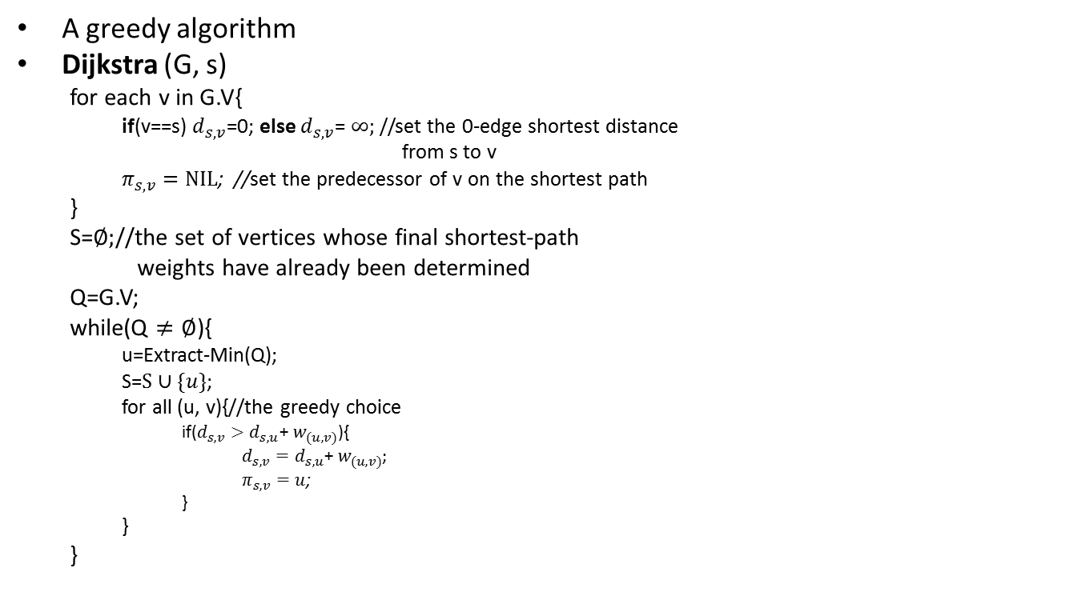
Dijkstra’s Algorithm
A greedy algorithm
Dijkstra (G, s)
for each v in G.V{
if(v==s) $d_{s,v}$=0; else $d_{s,v}$= $∞;$//set the 0-edge shortest distance
from s to v
$π_{s,v}=NIL$; //set the predecessor of v on the shortest path
}
S=$∅;$//the set of vertices whose final shortest-path
weights have already been determined
Q=G.V;
while(Q $≠∅$){
u=Extract-Min(Q);
S=$S∪\{u\}$;
for all (u, v){//the greedy choice
if($d_{s,v}>d_{s,u}$+ $w_{(u,v)}$){
$d_{s,v}=d_{s,u}\text{+ }w_{(u,v)}$;
$π_{s,v}=u$;
}
}
}
T(n)=O($V^{2}$)

Slide 23
Dijkstra's algorithm Pseudocode
dist[s] ←0 (distance to source vertex is zero) for all v ∈ V–{s} do dist[v] ←∞ (set all other distances to infinity) S←∅ (S, the set of visited vertices is initially empty) Q←V (Q, the queue initially contains all vertices) while Q ≠∅ (while the queue is not empty) do u ← mindistance(Q,dist) (select the element of Q with the min. distance) S←S ∈{u} (add u to list of visited vertices) for all v ∈ neighbors[u] do
dist[v]= min(dist[v], dist[u] + w(u, v)) (update distance)
return dist

Slide 24
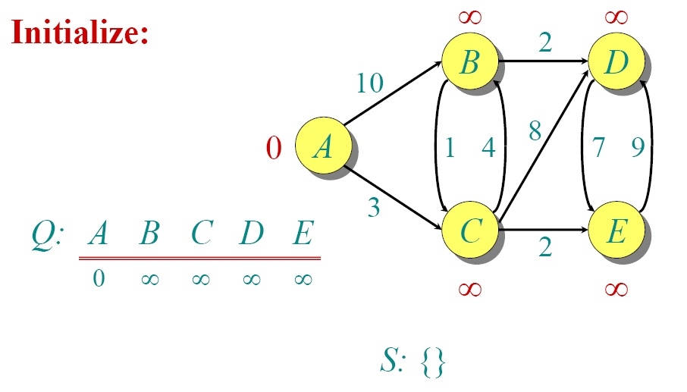
DIJKSTRA EXAMPLE
 | A | B | C | D | E
Π | / | / | / | / | /

Slide 25
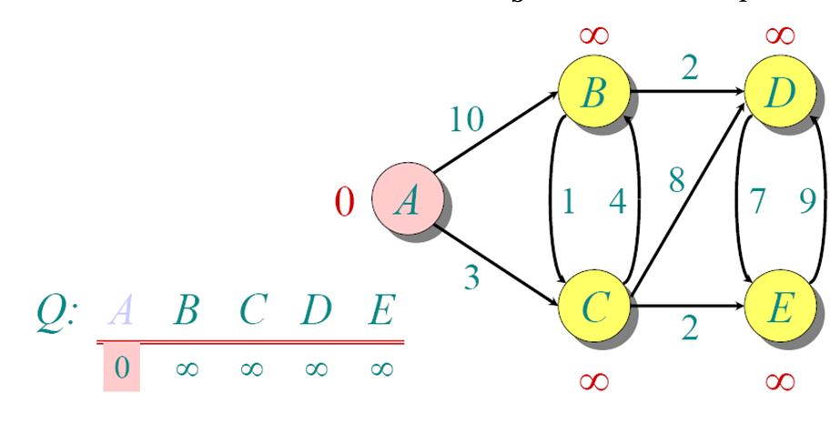
DIJKSTRA EXAMPLE
 | A | B | C | D | E
Π | / | / | / | / | /

Slide 26
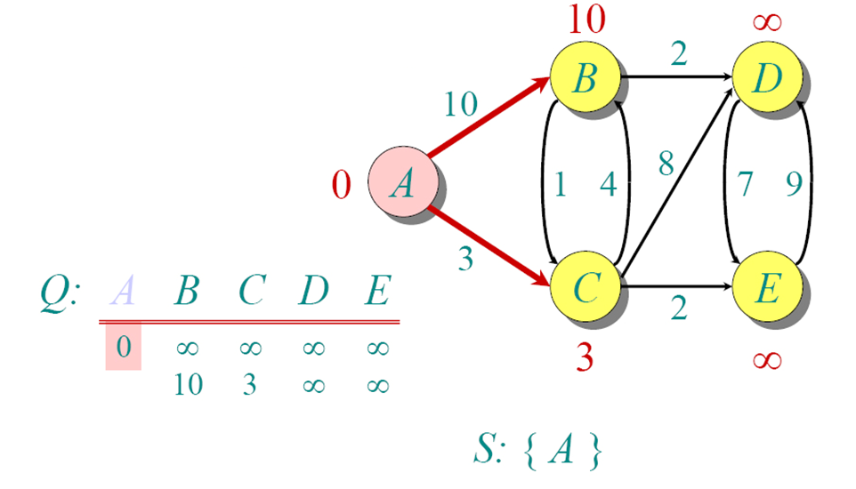
DIJKSTRA EXAMPLE
 | A | B | C | D | E
Π | / | A | A | / | /

Slide 27
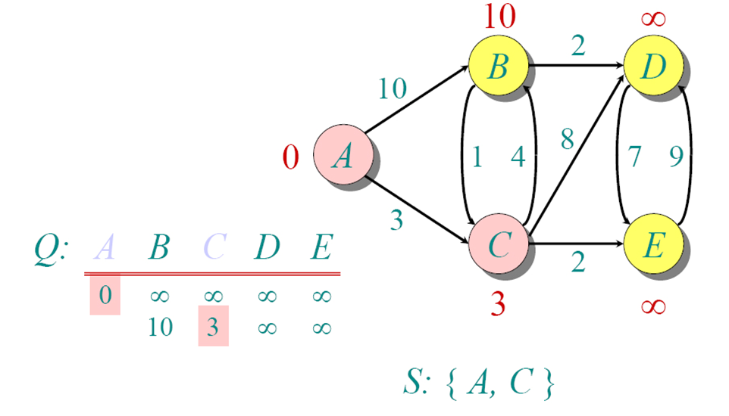
DIJKSTRA EXAMPLE
 | A | B | C | D | E
Π | / | A | A | / | /

Slide 28
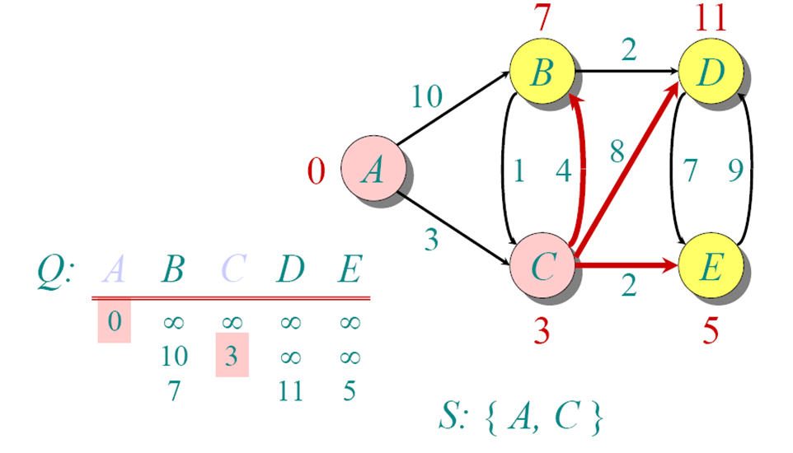
DIJKSTRA EXAMPLE

Slide 29
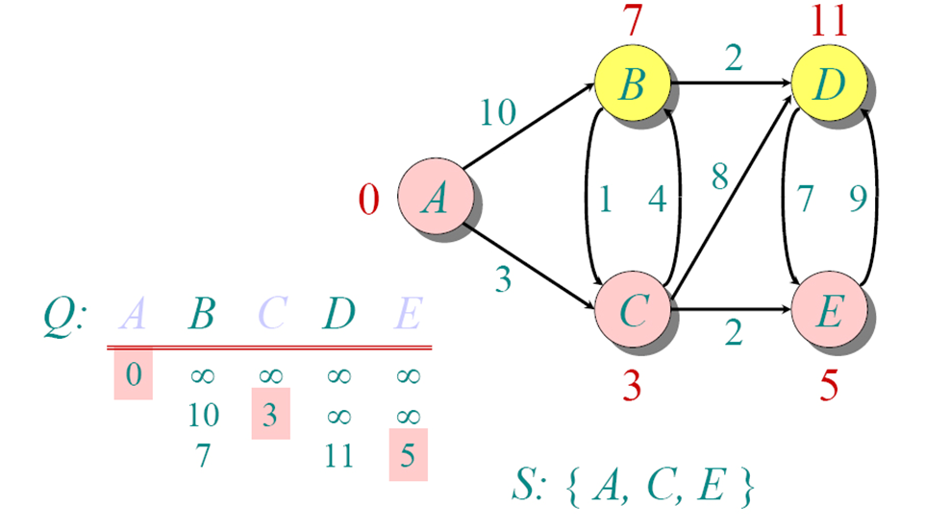
DIJKSTRA EXAMPLE
 | A | B | C | D | E
Π | / | C | A | C | C

Slide 30
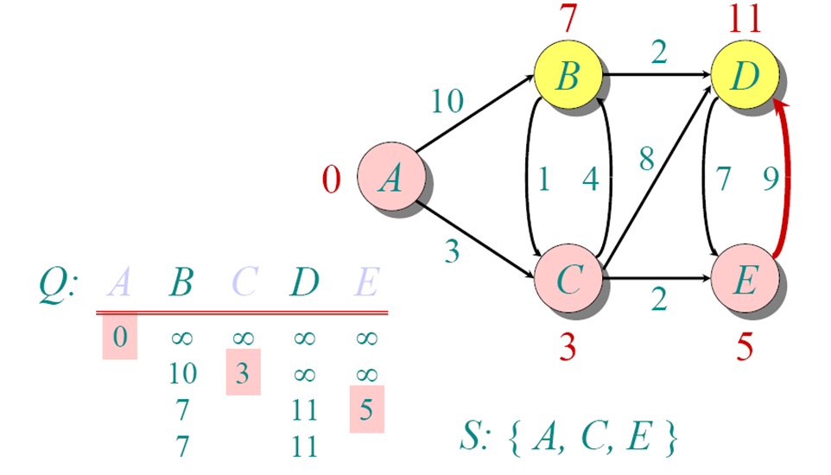
DIJKSTRA EXAMPLE

Slide 31
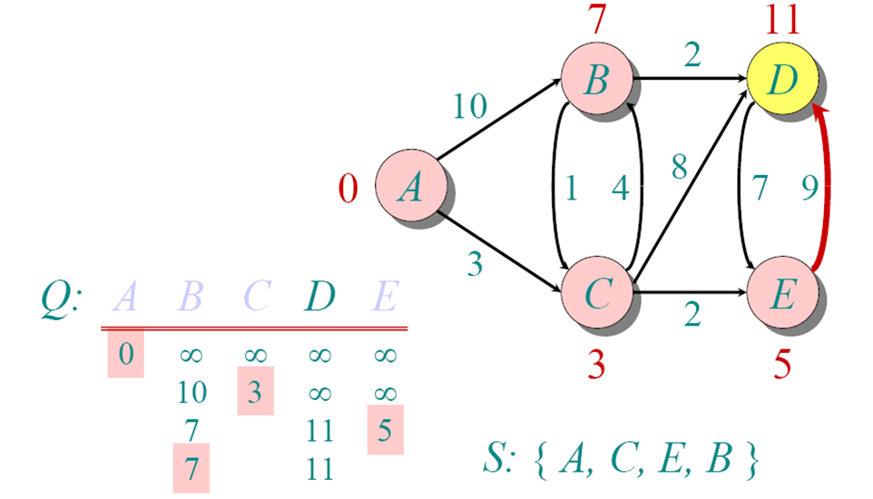
DIJKSTRA EXAMPLE
 | A | B | C | D | E
Π | / | C | A | C | C

Slide 32
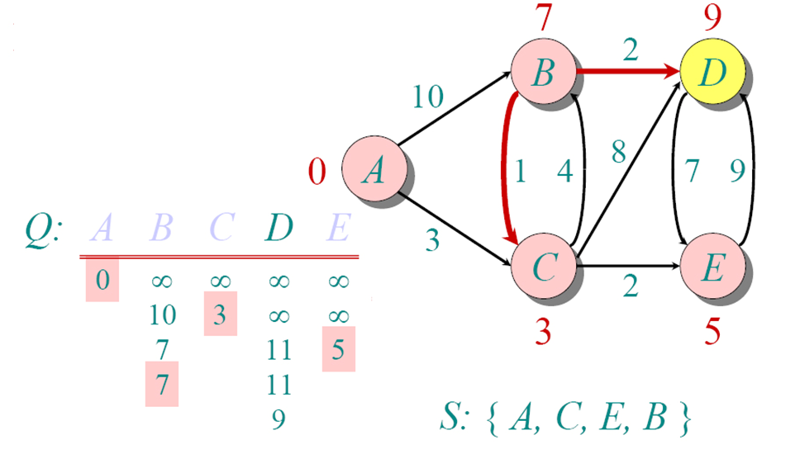
DIJKSTRA EXAMPLE

Slide 33
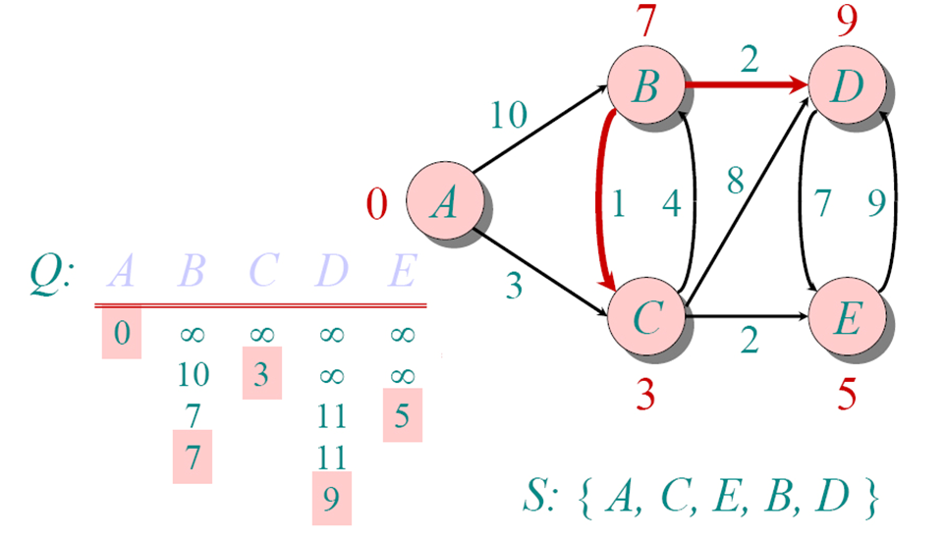
DIJKSTRA EXAMPLE
 | A | B | C | D | E
Π | / | C | A | B | C

Slide 34
Dijkstra's algorithm Pseudocode
dist[s] ←0 (distance to source vertex is zero) for all v ∈ V–{s} do dist[v] ←∞ (set all other distances to infinity) S←∅ (S, the set of visited vertices is initially empty) Q←V (Q, the queue initially contains all vertices) while Q ≠∅ (while the queue is not empty) do u ← mindistance(Q,dist) (select the element of Q with the min. distance) S←S ∈{u} (add u to list of visited vertices) for all v ∈ neighbors[u] do if dist[v] min(dist[v], dist[u] + w(u, v)) (update distance)
return dist

Slide 35
Dijkstra’s algorith Running Time
Initialization : Θ(V)
|V| iterations
Each iteration: Θ(V)
Total time: O(V²)

Slide 36



Dijkstra’s Algorithm
The shortest path of the vertex with smallest distance is determined
1
$$∞$$
$$/10$$
$$∞$$
2
3
10
0
3
2
9
1
6
4
5
7
4
5
$$∞$$
$$/5$$
$$∞$$
2

Slide 37




Dijkstra’s Algorithm
Choose a vertex whose shortest path is now determined
1
10
$$/8$$
$$∞$$
$$/14$$
2
3
10
0
3
2
9
1
6
4
5
7
4
5
$$5$$
$$∞$$
$$/7$$
2

Slide 38



Dijkstra’s Algorithm
Choose a vertex whose shortest path is now determined
1
14
8
$$/13$$
2
3
10
$$/0$$
9
0
3
2
1
6
4
5
7
4
5
$$5$$
$$7$$
2

Slide 39

Dijkstra’s Algorithm
Choose a vertex whose shortest path is now determined
1
$$/9$$
8
13
2
3
10
0
3
2
9
1
6
4
5
7
4
5
$$5$$
$$/5$$
$$7$$
2

Slide 40

Dijkstra’s Algorithm
Choose a vertex whose shortest path is now determined
1
8
9
2
3
10
0
3
2
9
1
6
4
5
7
4
5
$$5$$
$$7$$
$$/7$$
2

Slide 41
Dijkstra’s Algorithm
Final result:
1
8
9
2
3
10
0
3
2
9
1
6
4
5
7
4
5
$$5$$
$$7$$
2
What is the shortest path from 1 to 5?
1, 4, 5
What is the shortest path from 1 to 2, 3, and 4?
What is weight of this path?
7

Slide 42
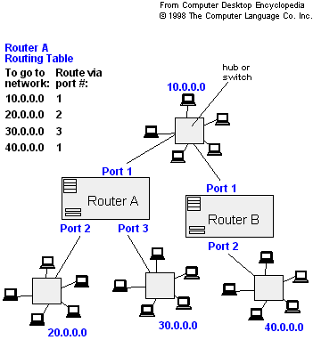
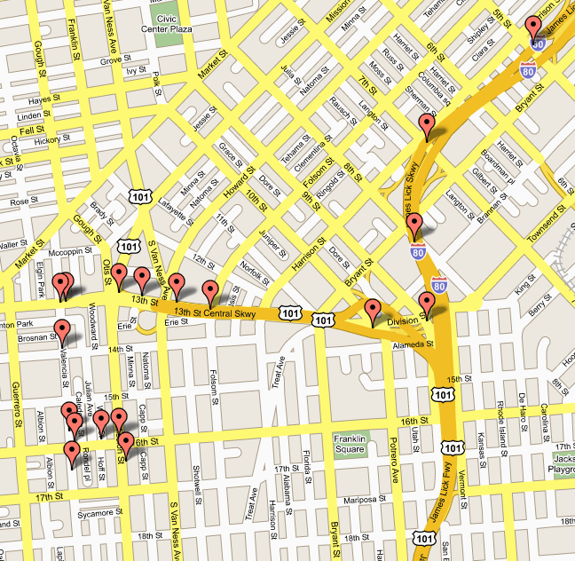
APPLICATIONS
- Traffic Information Systems are most prominent use
- Mapping (Map Quest, Google Maps)
- Routing Systems

Slide 43
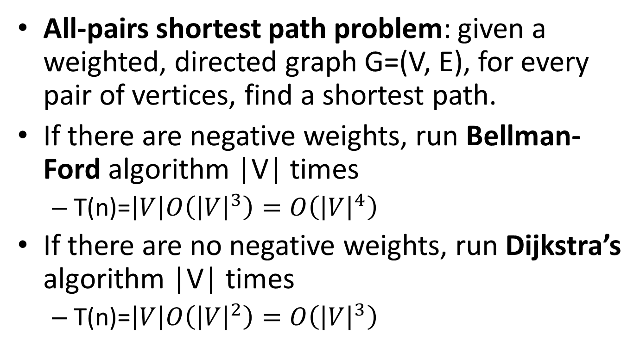
All-pairs shortest paths
All-pairs shortest path problem: given a weighted, directed graph G=(V, E), for every pair of vertices, find a shortest path.
If there are negative weights, run Bellman-Ford algorithm |V| times
T(n)=$\left|V\right|O\left({\left|V\right|}^{3}\right)=O\left({\left|V\right|}^{4}\right)$
If there are no negative weights, run Dijkstra’s algorithm |V| times
T(n)=$\left|V\right|O\left({\left|V\right|}^{2}\right)=O\left({\left|V\right|}^{3}\right)$

Slide 44
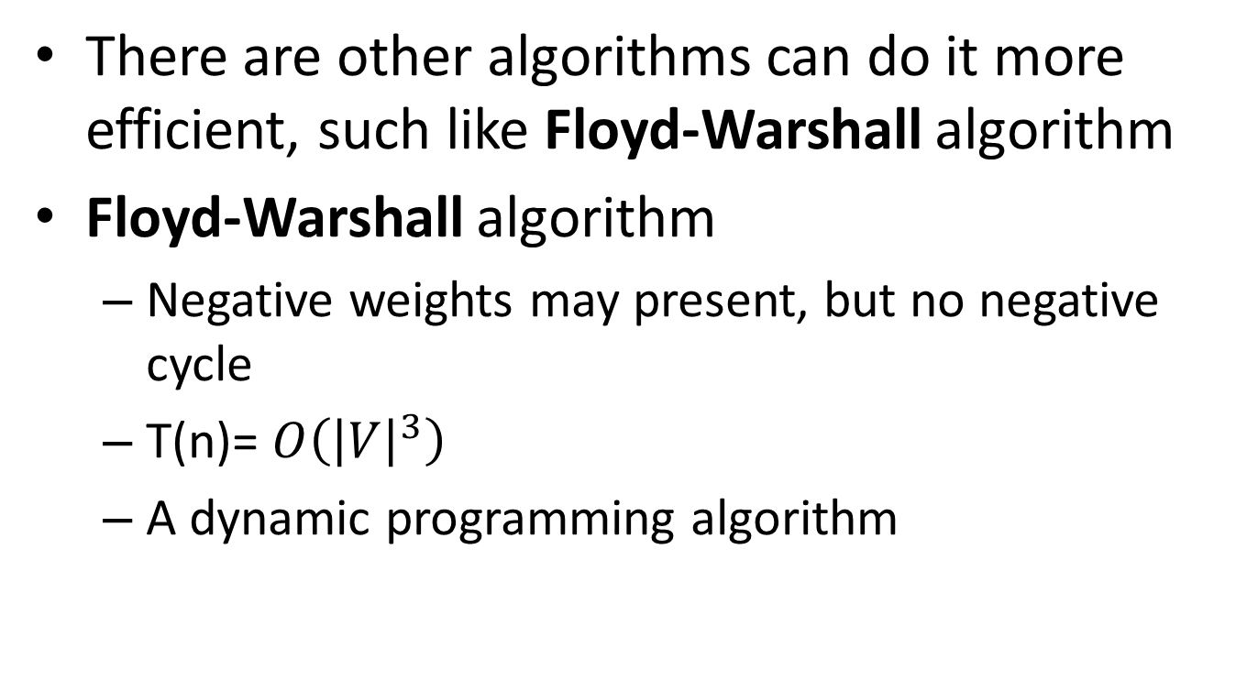
All-pairs shortest paths
There are other algorithms can do it more efficient, such like Floyd-Warshall algorithm
Floyd-Warshall algorithm
Negative weights may present, but no negative cycle
T(n)= $O\left({\left|V\right|}^{3}\right)$
A dynamic programming algorithm

Slide 45
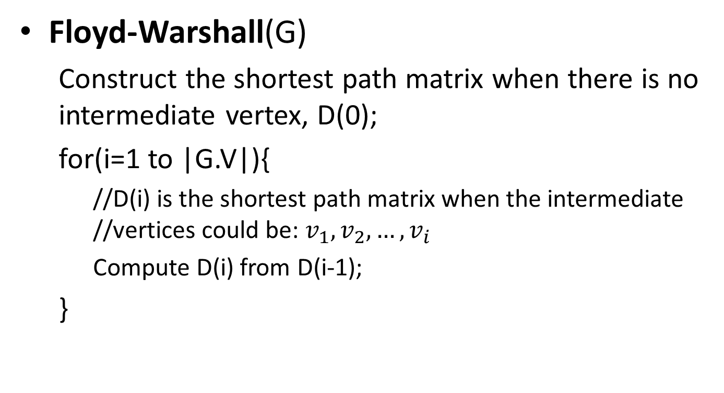
All-pairs shortest paths
Floyd-Warshall(G)
Construct the shortest path matrix when there is no intermediate vertex, D(0);
for(i=1 to |G.V|){
//D(i) is the shortest path matrix when the intermediate //vertices could be: $v_{1},v_{2}, …,v_{i}$
Compute D(i) from D(i-1);
}

Slide 46










All-pairs shortest paths
What are the weights of shortest paths with no intermediate vertices, D(0)?
1
2
 | 1 | 2 | 3 | 4
1
2
3
4
9
3
0
$$∞$$
$$∞$$
$$∞$$
6
4
$$∞$$
$$0$$
$$∞$$
4
3
$$9$$
$$0$$
2
3
4
$$∞$$
6
$$∞$$
0
2

Slide 47















All-pairs shortest paths
D(0)
 | 1 | 2 | 3 | 4
1
2
3
4
0
$$∞$$
$$∞$$
$$∞$$
1
2
$$∞$$
0
$$∞$$
4
3
2
0
9
2
$$∞$$
6
$$∞$$
0
3
6
4
What are the weights of shortest paths with intermediate vertex 1?
3
4
D(1)
 | 1 | 2 | 3 | 4
1
2
3
4
9
0
$$∞$$
$$∞$$
$$∞$$
$$∞$$
0
$$∞$$
4
3
$$2$$
0
9
$$∞$$
6
$$∞$$
0

Slide 48












All-pairs shortest paths
D(1)
 | 1 | 2 | 3 | 4
1
2
3
4
0
$$∞$$
$$∞$$
$$∞$$
1
2
$$∞$$
0
$$∞$$
4
3
$$2$$
0
9
2
$$∞$$
6
$$∞$$
0
3
4
6
4
What are the weights of shortest paths with intermediate vertices 1 and 2?
3
4
D(2)
 | 1 | 2 | 3 | 4
1
2
3
4
9
0
$$∞$$
$$∞$$
$$∞$$
$$∞$$
0
$$∞$$
4
3
$$2$$
0
6
$$∞$$
6
$$∞$$
0

Slide 49
















All-pairs shortest paths
D(2)
 | 1 | 2 | 3 | 4
1
2
3
4
0
$$∞$$
$$∞$$
$$∞$$
1
2
$$∞$$
$$∞$$
0
4
3
$$2$$
0
6
2
3
$$∞$$
6
$$∞$$
0
6
4
What are the weights of shortest paths with intermediate vertices 1, 2 and 3?
3
4
D(3)
 | 1 | 2 | 3 | 4
1
2
3
4
9
0
$$∞$$
$$∞$$
$$∞$$
$$∞$$
0
$$∞$$
4
3
$$2$$
0
6
$$∞$$
6
$$∞$$
0

Slide 50





All-pairs shortest paths
D(3)
 | 1 | 2 | 3 | 4
1
2
3
4
0
$$∞$$
$$∞$$
$$∞$$
1
2
$$∞$$
0
$$∞$$
4
3
$$2$$
0
6
2
$$∞$$
6
$$∞$$
0
3
6
4
What are the weights of shortest paths with intermediate vertices 1, 2, 3 and 4?
3
D(4)
4
 | 1 | 2 | 3 | 4
1
2
3
4
9
0
$$∞$$
$$∞$$
$$∞$$
$$∞$$
0
$$∞$$
4
3
$$2$$
0
6
$$∞$$
6
$$∞$$
0

Slide 51
































All-pairs shortest paths
Add predecessor information to reconstruct a shortest path
If updated the predecessor i-j in D(k) is the same as the predecessor k-j in D(k-1)
D(0)
D(1)
 | 1 | 2 | 3 | 4
1
2
3
4
 | 1 | 2 | 3 | 4
1
2
3
4
0/n
$$∞/n$$
$$∞/n$$
$$∞/n$$
0/n
$$∞/n$$
$$∞/n$$
$$∞/n$$
$$∞/n$$
0/n
$$∞/n$$
4/2
$$∞/n$$
0/n
$$∞/n$$
4/2
3/3
$$2/3$$
0/n
9/3
3/3
$$2/3$$
0/n
9/3
$$∞/n$$
6/4
$$∞/n$$
0/n
$$∞/n$$
6/4
$$∞/n$$
0/n
D(2)
D(3)
 | 1 | 2 | 3 | 4
1
2
3
4
 | 1 | 2 | 3 | 4
1
2
3
4
0/n
$$∞/n$$
$$∞/n$$
$$∞/n$$
0/n
$$∞/n$$
$$∞/n$$
$$∞/n$$
$$∞/n$$
0/n
$$∞/n$$
4/2
$$∞/n$$
0/n
$$∞/n$$
4/2
3/3
$$2/3$$
0/n
6/2
3/3
$$2/3$$
0/n
6/2
$$∞/n$$
6/4
$$∞/n$$
0/n
$$∞/n$$
6/4
$$∞/n$$
0/n

Slide 52








All-pairs shortest paths
D(4)
1
2
 | 1 | 2 | 3 | 4
1
2
3
4
0/n
$$∞/n$$
$$∞/n$$
$$∞/n$$
2
$$∞/n$$
4/2
3
$$∞/n$$
0/n
6
4
3/3
$$2/3$$
0/n
6/2
$$∞/n$$
6/4
$$∞/n$$
0/n
3
4
9
What is the shortest path from 3 to 4?
3, 2, 4
What is weight of this path?
6

Slide 53
Remarks
Dijkstra’s algorithm is a single source one
Bellman’s algorithm consider negative weights but for acyclic graphs
Floyd’s algorithm solves for the shortest path among all pairs of vertices.

